Slide 1




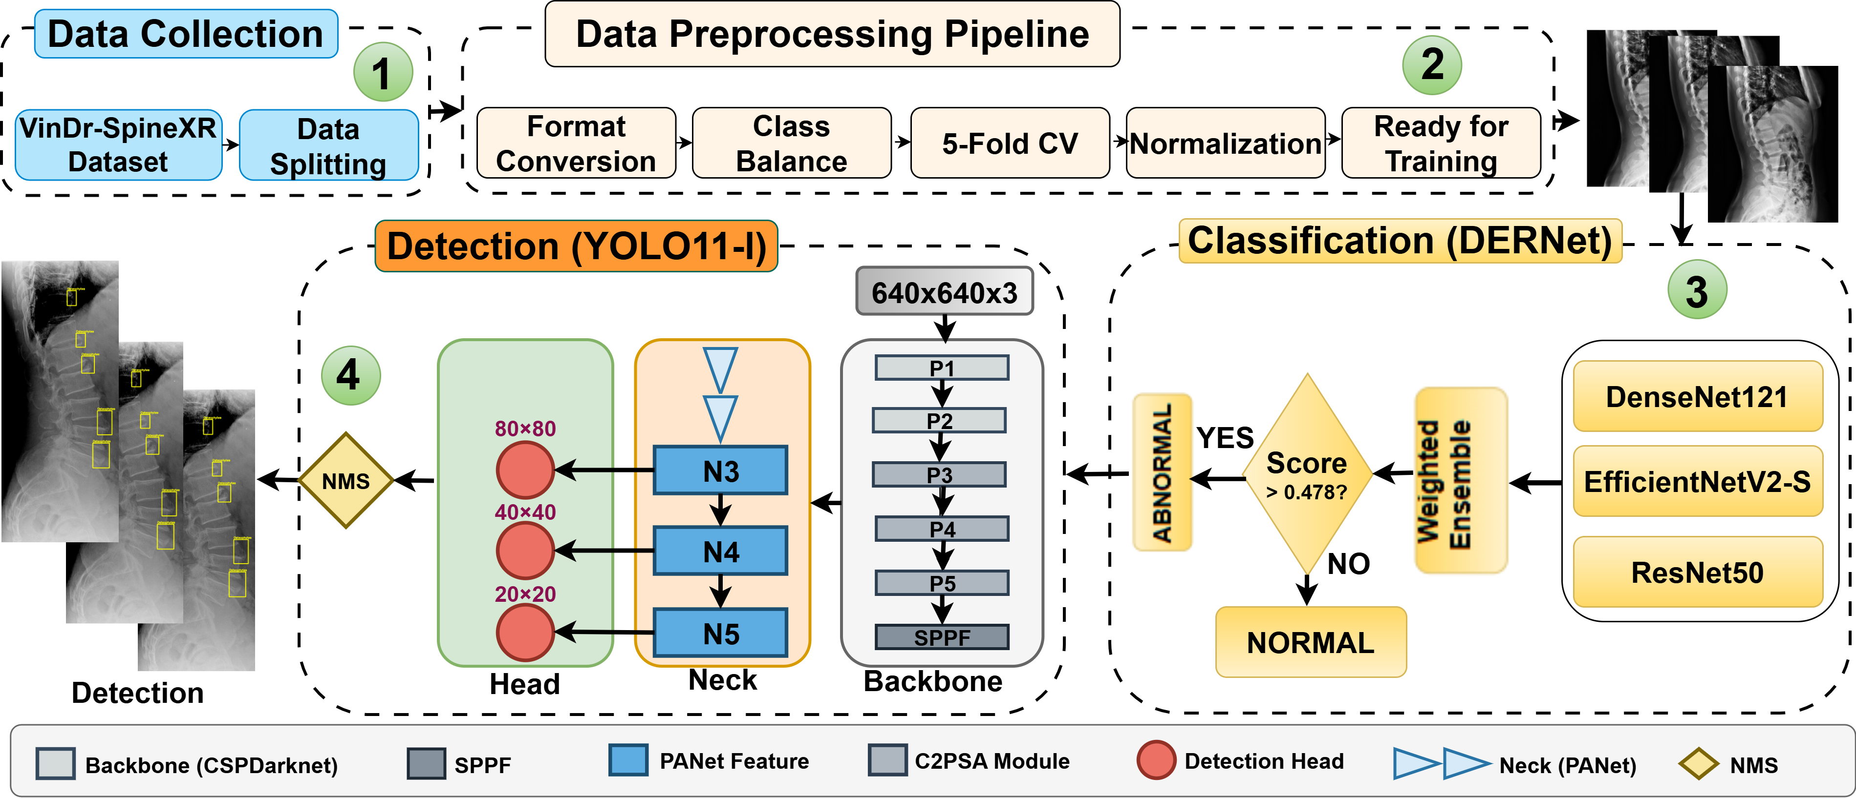
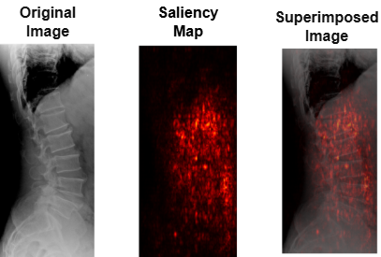
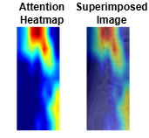
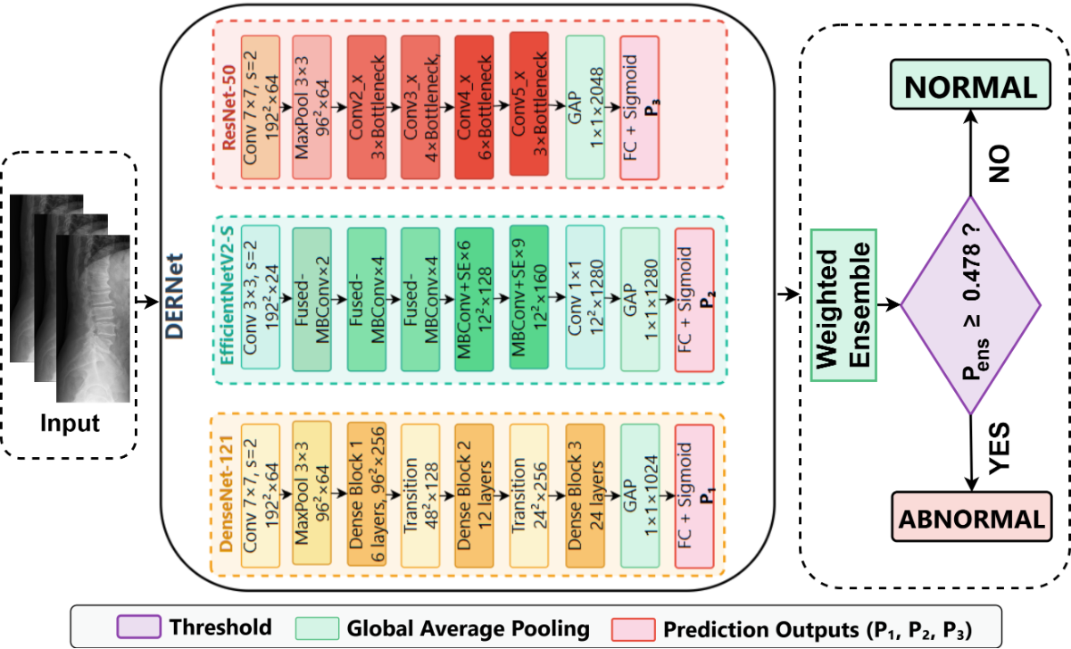
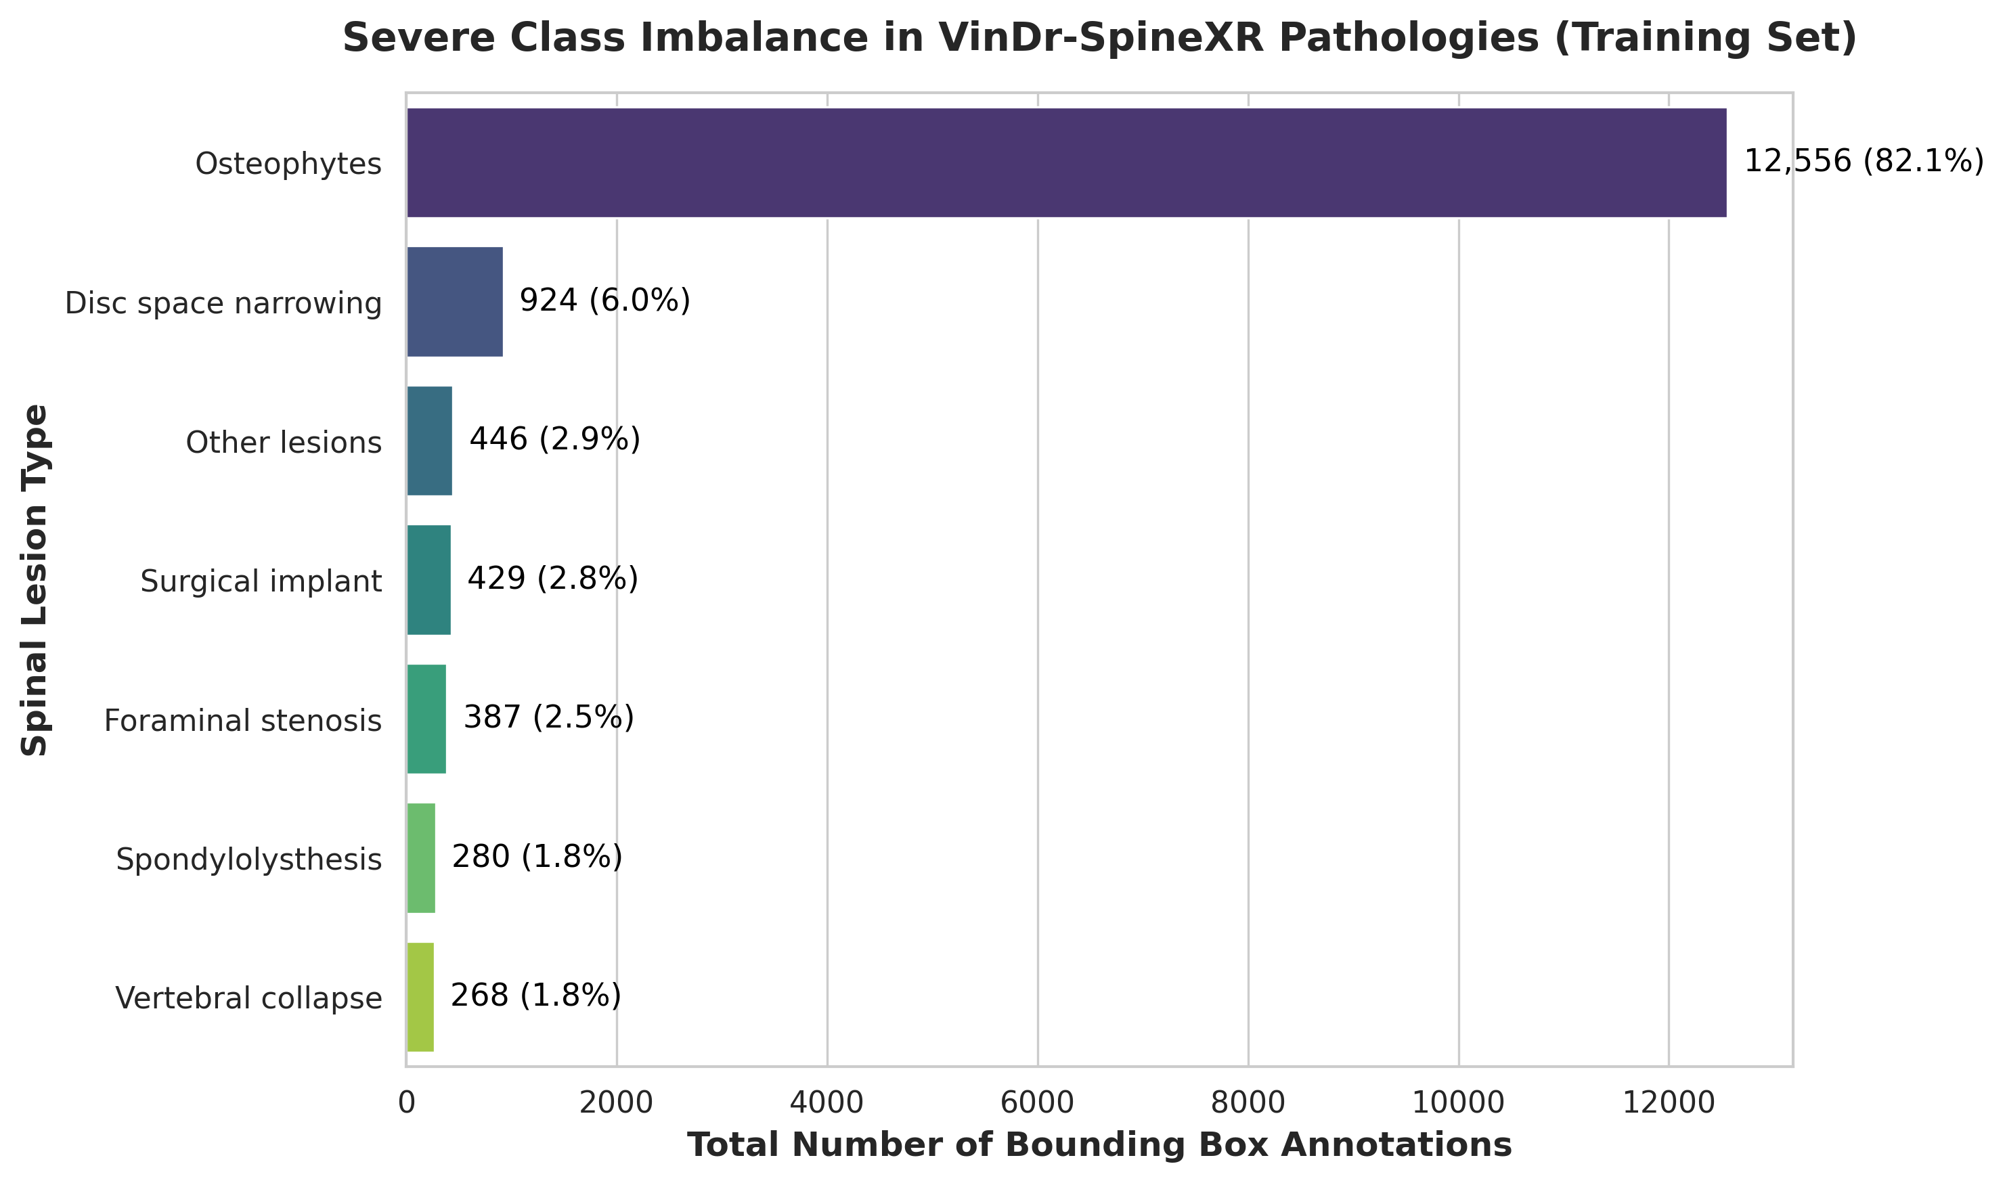

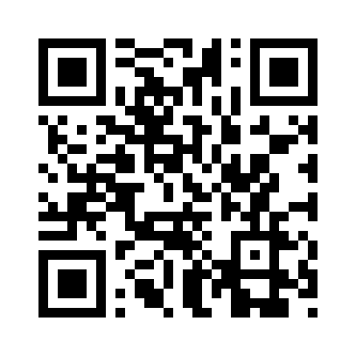

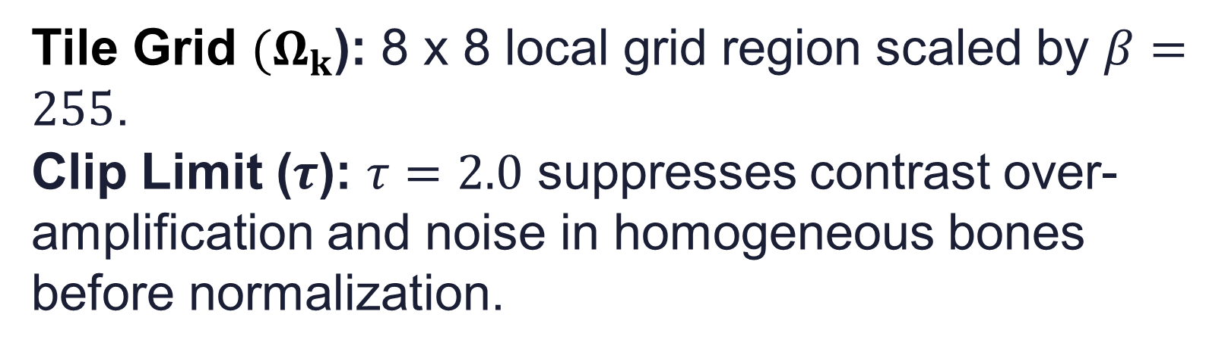
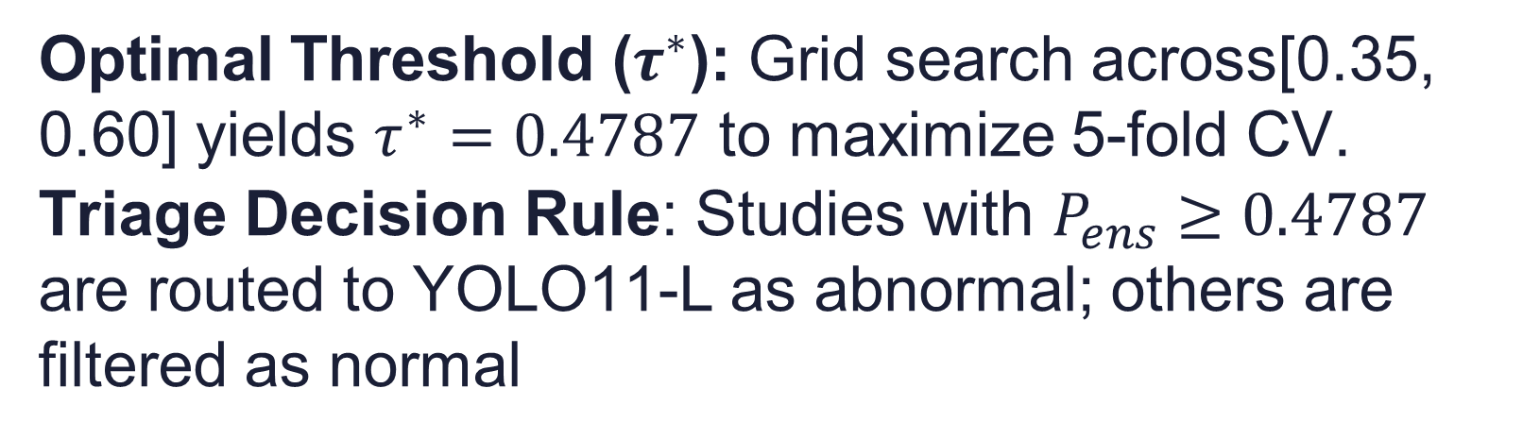
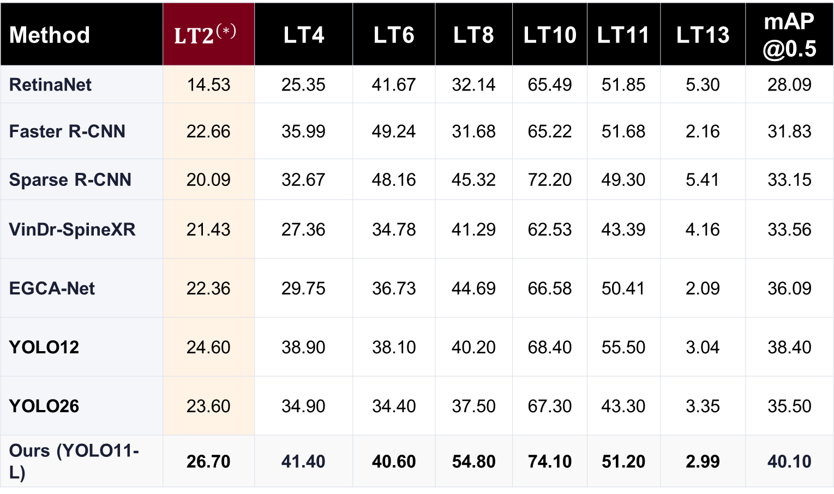
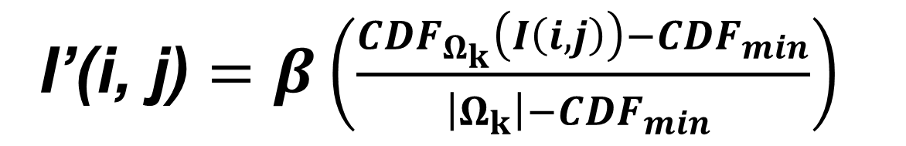
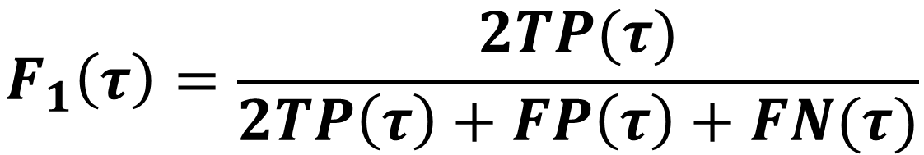
A Sensitivity-Gated Cascade for Compute-Efficient Spinal Lesion Detection in Resource-Constrained Settings
1
Prosenjit Mondol , Samrat Kumar Dey and Arpita Howlader
¹Faculty of Computer Science and Engineering, Patuakhali Science and Technology University, Dumki 8602, Bangladesh.
²School of Science and Technology, Bangladesh Open University, Gazipur 1705, Bangladesh
2
1
Motivation
  Proposed Cascaded Framework
  Results
Spinal radiographs serve as the primary screening modality for a wide spectrum of spinal pathologies [1]. This visual ambiguity induces high inter-observer variability and elevates the risk of delayed diagnoses, which can precipitate irreversible neurological sequelae.
Table 1. Classification performance comparison
Method | AUROC | F1 (%) | Sens. (%) | Spec. (%)
EfficientNetV2-S | 89.44 | 79.34 | 70.80 | 91.12
ResNet50 | 88.88 | 80.15 | 82.72 | 78.13
DenseNet121 | 86.93 | 79.55 | 80.39 | 79..32
VinDr Ensemble | 88.61 | 81.06 | 83.07 | 79.32
HealNNet | 88.84 | 81.20 | - | -
DERNet | 91.03 | 83.09 | 84.91 | 81.68
46.9 : 1
class imbalance ratio between majority (82.1%) and critical minority lesions [2]
Table 2. The detection performance for each type of spinal lesion.
<1%
of the radiograph field-of-view occupied by minute, subtle pathologies [2]
Method | $${LT2}^{(∗)}$$ | LT4 | LT6 | LT8 | LT10 | LT11 | LT13 | mAP@0.5
RetinaNet | 14.53 | 25.35 | 41.67 | 32.14 | 65.49 | 51.85 | 5.30 | 28.09
Faster R-CNN | 22.66 | 35.99 | 49.24 | 31.68 | 65.22 | 51.68 | 2.16 | 31.83
Sparse R-CNN | 20.09 | 32.67 | 48.16 | 45.32 | 72.20 | 49.30 | 5.41 | 33.15
VinDr-SpineXR | 21.43 | 27.36 | 34.78 | 41.29 | 62.53 | 43.39 | 4.16 | 33.56
EGCA-Net | 22.36 | 29.75 | 36.73 | 44.69 | 66.58 | 50.41 | 2.09 | 36.09
YOLO12 | 24.60 | 38.90 | 38.10 | 40.20 | 68.40 | 55.50 | 3.04 | 38.40
YOLO26 | 23.60 | 34.90 | 34.40 | 37.50 | 67.30 | 43.30 | 3.35 | 35.50
Ours (YOLO11-L) | 26.70 | 41.40 | 40.60 | 54.80 | 74.10 | 51.20 | 2.99 | 40.10
  Gaps in Current Approaches
Fig. 2. Overview of the cascaded framework for spinal
lesion triage and localization.
1
Sensitivity-Specificity Trade-Off
Monolithic models trigger high false positives or miss critical subtle lesions under data skew [3]
To mitigate radiographic exposure variance CLAHE computes the enhanced intensity by mapping the local CDF as
2
Extreme Class Imbalance
Minute pathologies (<1% FOV) are easily obscured by bone superposition and dominant classes [4-5]
I’(i, j) $=β\left(\frac{CDF_{Ω_{k}}\left(I\left(i,j\right)\right)−CDF_{min}}{\left|Ω_{k}\right|−CDF_{min} }\right)$
3
High Computational Overhead
Tile Grid ${(Ω}_{k}$): 8 x 8 local grid region scaled by $β=255$.
Clip Limit ($τ$): $τ=2.0$ suppresses contrast over-amplification and noise in homogeneous bones before normalization.
(*) LT2, LT4, LT6, LT8, LT10, LT11, and LT13 denote disc space
narrowing, foraminal stenosis, osteophytes, spondylolisthesis,
surgical implant, vertebral collapse, and other lesions, respectively.
Running heavy detectors on normal screening X-rays prevents CPU deployment in low-resource clinics[1,6]
  AI Explainability (XAI)
  Contributions
Sensitivity-Gated Cascade DERNet Framework
  DERNet Framework
Heterogeneous ensemble of DenseNet121, EfficientNetV2-S, and ResNet50 with weighted soft voting, achieving 91.03% AUROC to filter normal studies.
Attention-Guided Localization
Fig. 4. Multi-modal XAI validation verifies attention on genuine lesion pathology rather than artifacts
Customized YOLO11-L with CSP-Darknet and C2PSA attention to overcome severe class imbalance and localize minute lesions, achieving 40.10% mAP@0.5.
  Efficiency & Ablation
Transparent & Compute-Efficient Inference
CPU Triage
15.4 GFLOPS screening filters normals upfront; heavier 74.6 GFLOPS detector executes on abnormalities for CPU triage.
Integrates multi-modal explainability Saliency Maps, Grad-CAM, and LIME quantitatively grounded to authentic lesions, coupled with a staged pipeline optimized for practical CPU deployment in resource-constrained setting.
Imbalance Ablation
20% copy-paste lifts mAP@0.5 from 37.70% → 40.10% on rare lesions.
  Spine Lesion Distribution
Anatomical Trust
0.61–0.64 mean X-IoU grounds triage to bone margins, safeguarding scarce MRI slots.
  Conclusion
Fig. 3. DERNet probabilistic ensemble architecture for high-sensitivity radiographic triage. Each backbone (DenseNet121, EfficientNetV2-S, ResNet50) produces independent posterior probabilities via Global Average Pooling and Sigmoid.
Decouples screening triage from localization via a sensitivity-gated DERNet and YOLO11-L cascade. Delivers 91.03% AUROC and 40.10% mAP@0.5, quantitatively grounded to authentic bone pathology (0.64 X-IoU). Enables CPU-efficient triage (120 ms) in resource-constrained clinics, strictly reserving scarce MRI slots.
Fig. 1. Severe class imbalance across seven spinal lesion categories in the VinDr-SpineXR training cohort
The optimal threshold was found via a grid search with a step size of 0.0002, maximizing the 5-fold cross validation F1-score on the training data, as
Scan this QR for additional resources including code, data
Dataset & Cohort
$$τ^{∗}=arg max_{τ∈\left[0.35, 0.60\right]} F_{1}(τ)$$
Cohort: 8,389 training | 2077 test studies
Pathology Annotation: 15,290 expert-labeled bounding boxes across 7 lesion classes
Severe Class Skew: Osteophytes comprise 82.1%, while critical findings like Vertebral Collapse represent only 1.8% of all annotations
Minute Scale: Subtle lesions occupy <1% FOV (<32×32 px) amid overlapping bone anatomy
$$F_{1}\left(τ\right)=\frac{2TP(τ)}{2TP\left(τ\right)+FP\left(τ\right)+FN(τ)}$$
REFERENCES
Optimal Threshold ($τ^{∗}$): Grid search across[0.35, 0.60] yields $τ^{∗}=0.4787$ to maximize 5-fold CV.
Triage Decision Rule: Studies with $P_{ens}≥0.4787$ are routed to YOLO11-L as abnormal; others are filtered as normal
[1] A deep learning framework for spinal lesions detection and classification from radiographs. pages 291–301. Springer, 2021.
[2] VinDr-SpineXR: A large annotated medical image dataset for spinal lesions detection and classification from radiographs. PhysioNet, August 2021. Version 1.0.0.
[3] Sparse r-cnn: End-to-end object detection with learnable proposals. In Proceedings of the IEEE/CVFconference, 2021.
[4] Federated vision transformer with adaptive focal loss for medical image classifica-tion. Knowledge-Based Systems, 2026.
[5] Elizabeth A Krupinski, Kevin S Berbaum, RT Caldwell, KM Schartz, and J Kim. Long radiology workdays reduce detection and accommodation accuracy.
[6] Healnnet-lesions: A deep learning framework for spinal lesiondetection demonstrating x-ray images as a screening alternative to mri and ct withdeep learning in radiology. 2025
From the Computation Informatics & Machine Intelligence Lab (CIMILab)

Slide 2
A Sensitivity-Gated Cascade for Compute-Efficient Spinal Lesion Detection in Resource-Constrained Settings
1
Prosenjit Mondol , Samrat Kumar Dey and Arpita Howlader
¹Faculty of Computer Science and Engineering, Patuakhali Science and Technology University, Dumki 8602, Bangladesh.
²School of Science and Technology, Bangladesh Open University, Gazipur 1705, Bangladesh
2
1
Motivation
  Proposed Cascaded Framework
  Results
Spinal radiographs serve as the primary screening modality for a wide spectrum of spinal pathologies [1]. This visual ambiguity induces high inter-observer variability and elevates the risk of delayed diagnoses, which can precipitate irreversible neurological sequelae.
Table 1. Classification performance comparison
Method | AUROC | F1 (%) | Sens. (%) | Spec. (%)
EfficientNetV2-S | 89.44 | 79.34 | 70.80 | 91.12
ResNet50 | 88.88 | 80.15 | 82.72 | 78.13
DenseNet121 | 86.93 | 79.55 | 80.39 | 79..32
VinDr Ensemble | 88.61 | 81.06 | 83.07 | 79.32
HealNNet | 88.84 | 81.20 | - | -
DERNet | 91.03 | 83.09 | 84.91 | 81.68
46.9 : 1
class imbalance ratio between majority (82.1%) and critical minority lesions [2]
Table 2. The detection performance for each type of spinal lesion.
<1%
of the radiograph field-of-view occupied by minute, subtle pathologies [2]
Method | $${LT2}^{(∗)}$$ | LT4 | LT6 | LT8 | LT10 | LT11 | LT13 | mAP@0.5
RetinaNet | 14.53 | 25.35 | 41.67 | 32.14 | 65.49 | 51.85 | 5.30 | 28.09
Faster R-CNN | 22.66 | 35.99 | 49.24 | 31.68 | 65.22 | 51.68 | 2.16 | 31.83
Sparse R-CNN | 20.09 | 32.67 | 48.16 | 45.32 | 72.20 | 49.30 | 5.41 | 33.15
VinDr-SpineXR | 21.43 | 27.36 | 34.78 | 41.29 | 62.53 | 43.39 | 4.16 | 33.56
EGCA-Net | 22.36 | 29.75 | 36.73 | 44.69 | 66.58 | 50.41 | 2.09 | 36.09
YOLO12 | 24.60 | 38.90 | 38.10 | 40.20 | 68.40 | 55.50 | 3.04 | 38.40
YOLO26 | 23.60 | 34.90 | 34.40 | 37.50 | 67.30 | 43.30 | 3.35 | 35.50
Ours (YOLO11-L) | 26.70 | 41.40 | 40.60 | 54.80 | 74.10 | 51.20 | 2.99 | 40.10
  Gaps in Current Approaches
Fig. 2. Overview of the cascaded framework for spinal
lesion triage and localization.
1
Sensitivity-Specificity Trade-Off
Monolithic models trigger high false positives or miss critical subtle lesions under data skew [3]
To mitigate radiographic exposure variance CLAHE computes the enhanced intensity by mapping the local CDF as
2
Extreme Class Imbalance
Minute pathologies (<1% FOV) are easily obscured by bone superposition and dominant classes [4-5]
I’(i, j) $=β\left(\frac{CDF_{Ω_{k}}\left(I\left(i,j\right)\right)−CDF_{min}}{\left|Ω_{k}\right|−CDF_{min} }\right)$
3
High Computational Overhead
Tile Grid ${(Ω}_{k}$): 8 x 8 local grid region scaled by $β=255$.
Clip Limit ($τ$): $τ=2.0$ suppresses contrast over-amplification and noise in homogeneous bones before normalization.
(*) LT2, LT4, LT6, LT8, LT10, LT11, and LT13 denote disc space
narrowing, foraminal stenosis, osteophytes, spondylolisthesis,
surgical implant, vertebral collapse, and other lesions, respectively.
Running heavy detectors on normal screening X-rays prevents CPU deployment in low-resource clinics[1,6]
  AI Explainability (XAI)
  Contributions
Sensitivity-Gated Cascade DERNet Framework
  DERNet Framework
Heterogeneous ensemble of DenseNet121, EfficientNetV2-S, and ResNet50 with weighted soft voting, achieving 91.03% AUROC to filter normal studies.
Attention-Guided Localization
Fig. 4. Multi-modal XAI validation verifies attention on genuine lesion pathology rather than artifacts
Customized YOLO11-L with CSP-Darknet and C2PSA attention to overcome severe class imbalance and localize minute lesions, achieving 40.10% mAP@0.5.
  Efficiency & Ablation
Transparent & Compute-Efficient Inference
CPU Triage
15.4 GFLOPS screening filters normals upfront; heavier 74.6 GFLOPS detector executes on abnormalities for CPU triage.
Integrates multi-modal explainability Saliency Maps, Grad-CAM, and LIME quantitatively grounded to authentic lesions, coupled with a staged pipeline optimized for practical CPU deployment in resource-constrained setting.
Imbalance Ablation
20% copy-paste lifts mAP@0.5 from 37.70% → 40.10% on rare lesions.
  Spine Lesion Distribution
Anatomical Trust
0.61–0.64 mean X-IoU grounds triage to bone margins, safeguarding scarce MRI slots.
  Conclusion
Fig. 3. DERNet probabilistic ensemble architecture for high-sensitivity radiographic triage. Each backbone (DenseNet121, EfficientNetV2-S, ResNet50) produces independent posterior probabilities via Global Average Pooling and Sigmoid.
Decouples screening triage from localization via a sensitivity-gated DERNet and YOLO11-L cascade. Delivers 91.03% AUROC and 40.10% mAP@0.5, quantitatively grounded to authentic bone pathology (0.64 X-IoU). Enables CPU-efficient triage (120 ms) in resource-constrained clinics, strictly reserving scarce MRI slots.
Fig. 1. Severe class imbalance across seven spinal lesion categories in the VinDr-SpineXR training cohort
The optimal threshold was found via a grid search with a step size of 0.0002, maximizing the 5-fold cross validation F1-score on the training data, as
Scan this QR for additional resources including code, data
Dataset & Cohort
$$τ^{∗}=arg max_{τ∈\left[0.35, 0.60\right]} F_{1}(τ)$$
Cohort: 8,389 training | 2077 test studies
Pathology Annotation: 15,290 expert-labeled bounding boxes across 7 lesion classes
Severe Class Skew: Osteophytes comprise 82.1%, while critical findings like Vertebral Collapse represent only 1.8% of all annotations
Minute Scale: Subtle lesions occupy <1% FOV (<32×32 px) amid overlapping bone anatomy
$$F_{1}\left(τ\right)=\frac{2TP(τ)}{2TP\left(τ\right)+FP\left(τ\right)+FN(τ)}$$
REFERENCES
Optimal Threshold ($τ^{∗}$): Grid search across[0.35, 0.60] yields $τ^{∗}=0.4787$ to maximize 5-fold CV.
Triage Decision Rule: Studies with $P_{ens}≥0.4787$ are routed to YOLO11-L as abnormal; others are filtered as normal
[1] A deep learning framework for spinal lesions detection and classification from radiographs. pages 291–301. Springer, 2021.
[2] VinDr-SpineXR: A large annotated medical image dataset for spinal lesions detection and classification from radiographs. PhysioNet, August 2021. Version 1.0.0.
[3] Sparse r-cnn: End-to-end object detection with learnable proposals. In Proceedings of the IEEE/CVFconference, 2021.
[4] Federated vision transformer with adaptive focal loss for medical image classifica-tion. Knowledge-Based Systems, 2026.
[5] Elizabeth A Krupinski, Kevin S Berbaum, RT Caldwell, KM Schartz, and J Kim. Long radiology workdays reduce detection and accommodation accuracy.
[6] Healnnet-lesions: A deep learning framework for spinal lesiondetection demonstrating x-ray images as a screening alternative to mri and ct withdeep learning in radiology. 2025

